Slide 1

Model Validation @DETERMINED 2022 Workshop
Dr. U. Michelucci (TOELT)

Slide 2
Overfitting
A network may, due to its flexibility, learn patterns that are due to noise, errors or simply wrong data.
How can we detect it? How can we visualise its occurrence?

Slide 3
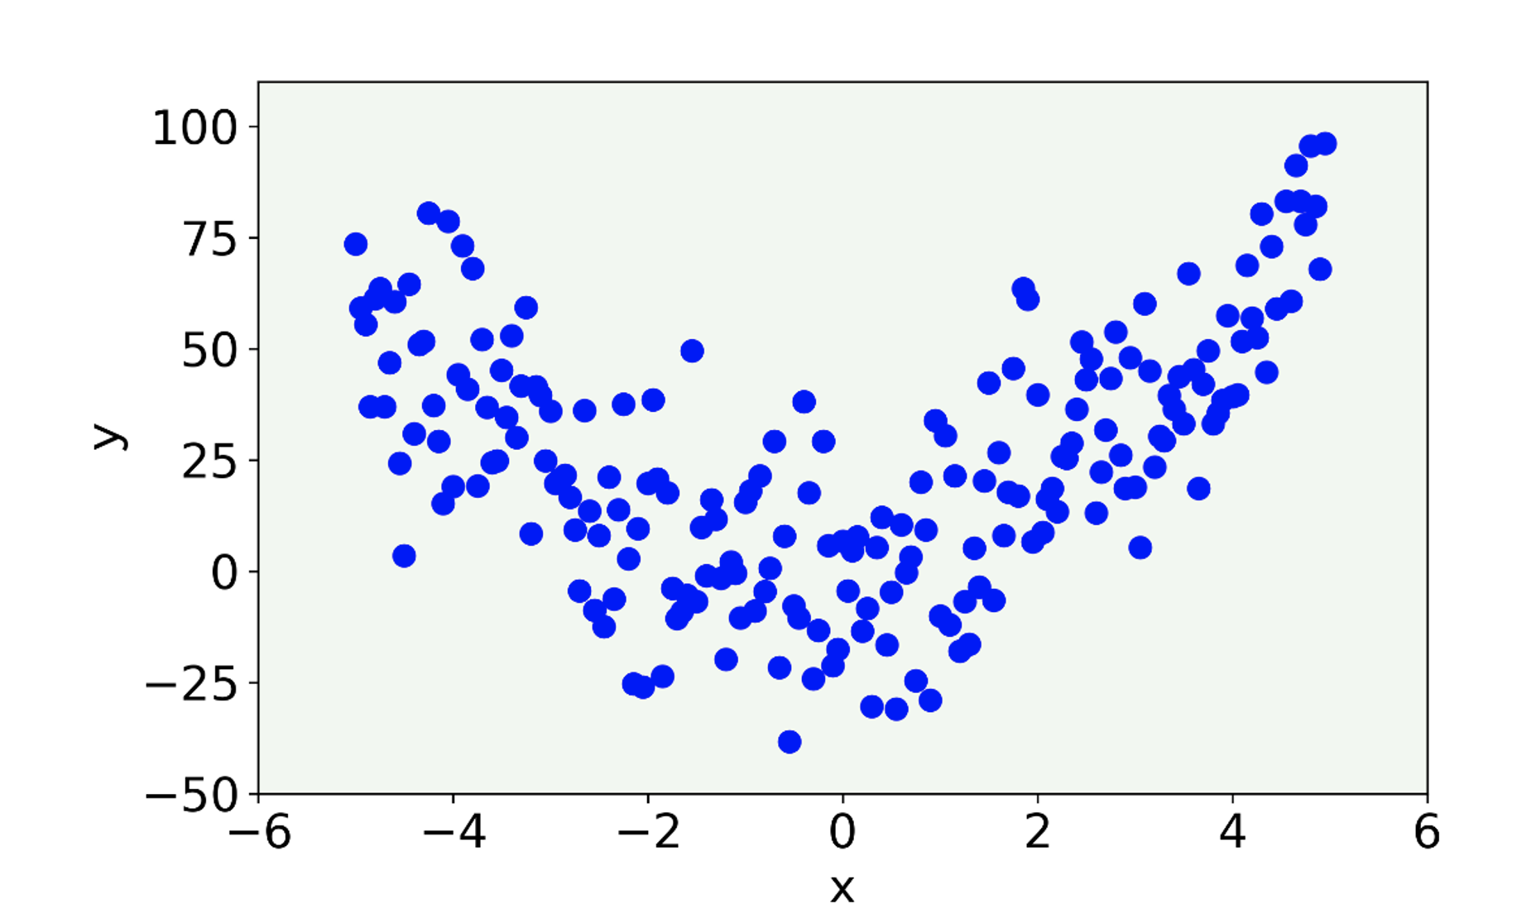
Overfitting I
Let us consider a set of data with some noise.
U. Michelucci, Applied Deep Learning with TensorFlow 2, Springer Nature, 2022

Slide 4
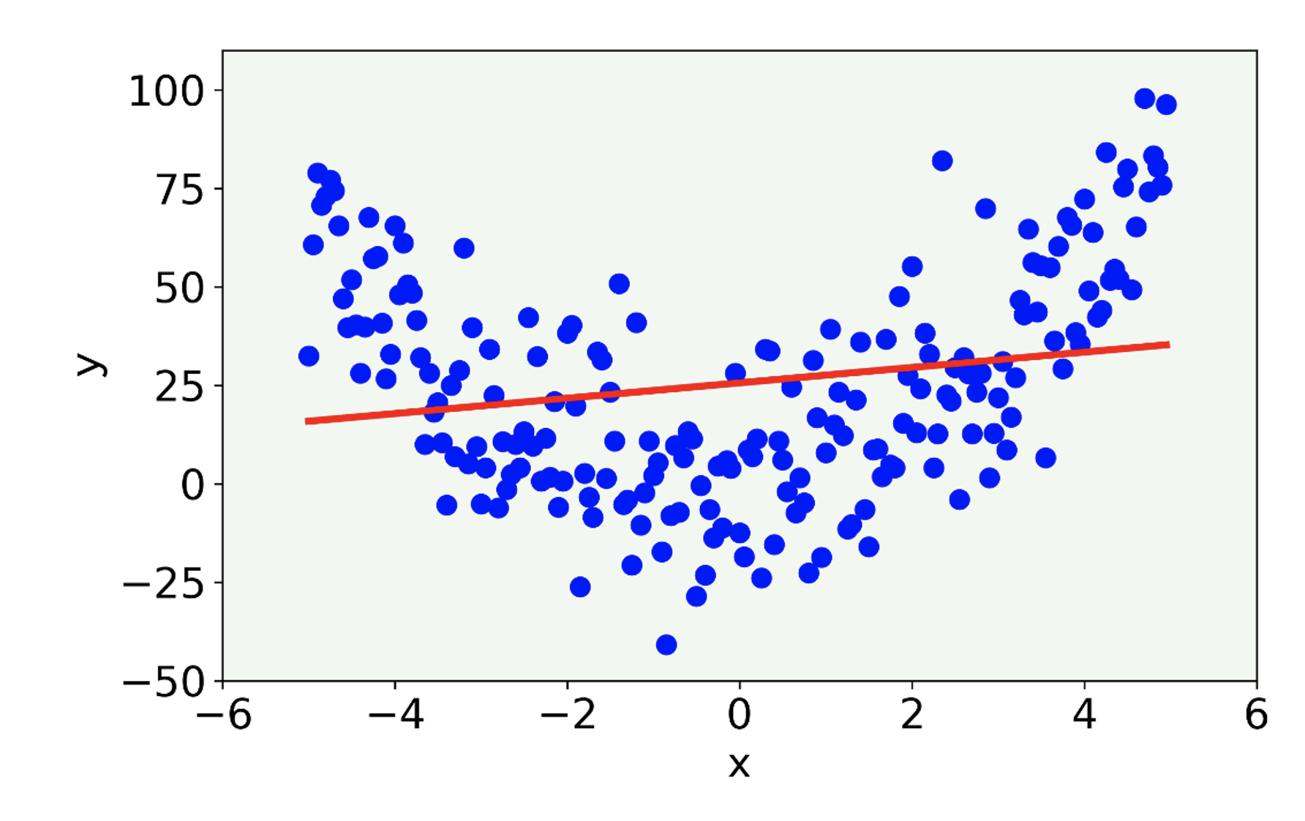
Overfitting II
The linear model misses the main features of the data being too simple. In this case the model has high bias.
U. Michelucci, Applied Deep Learning with TensorFlow 2, Springer Nature, 2022

Slide 5
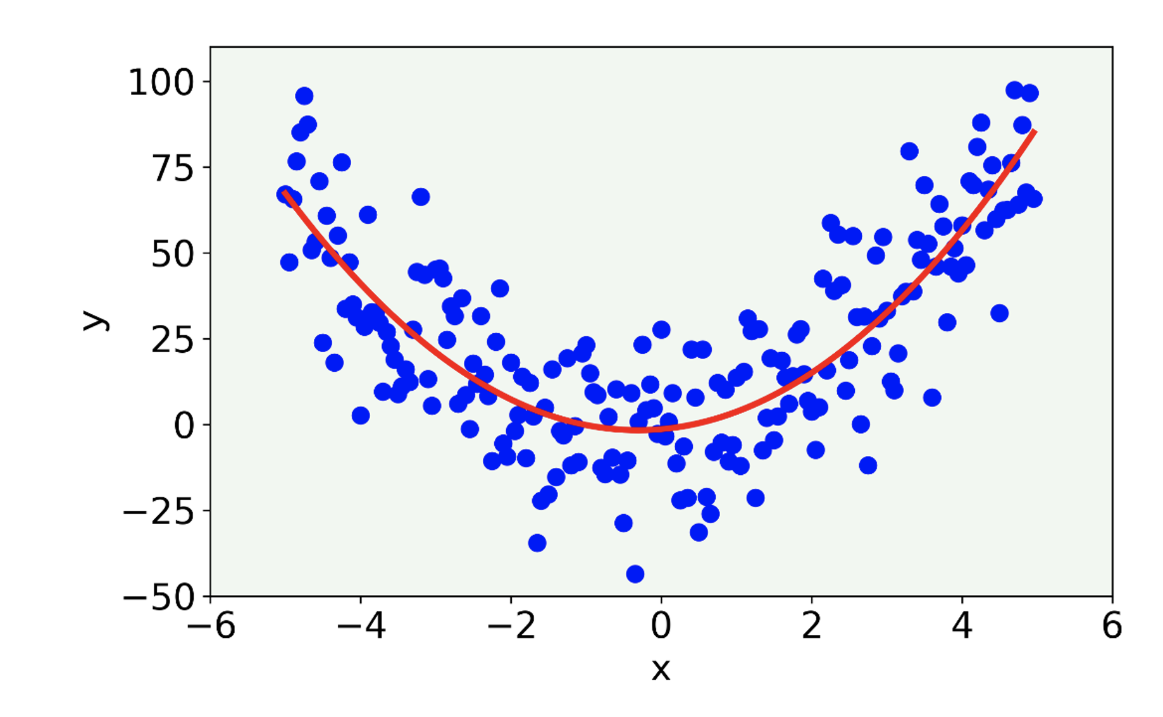
Overfitting III
The result (red line) for a 2-degree polynomial.
U. Michelucci, Applied Deep Learning with TensorFlow 2, Springer Nature, 2022

Slide 6
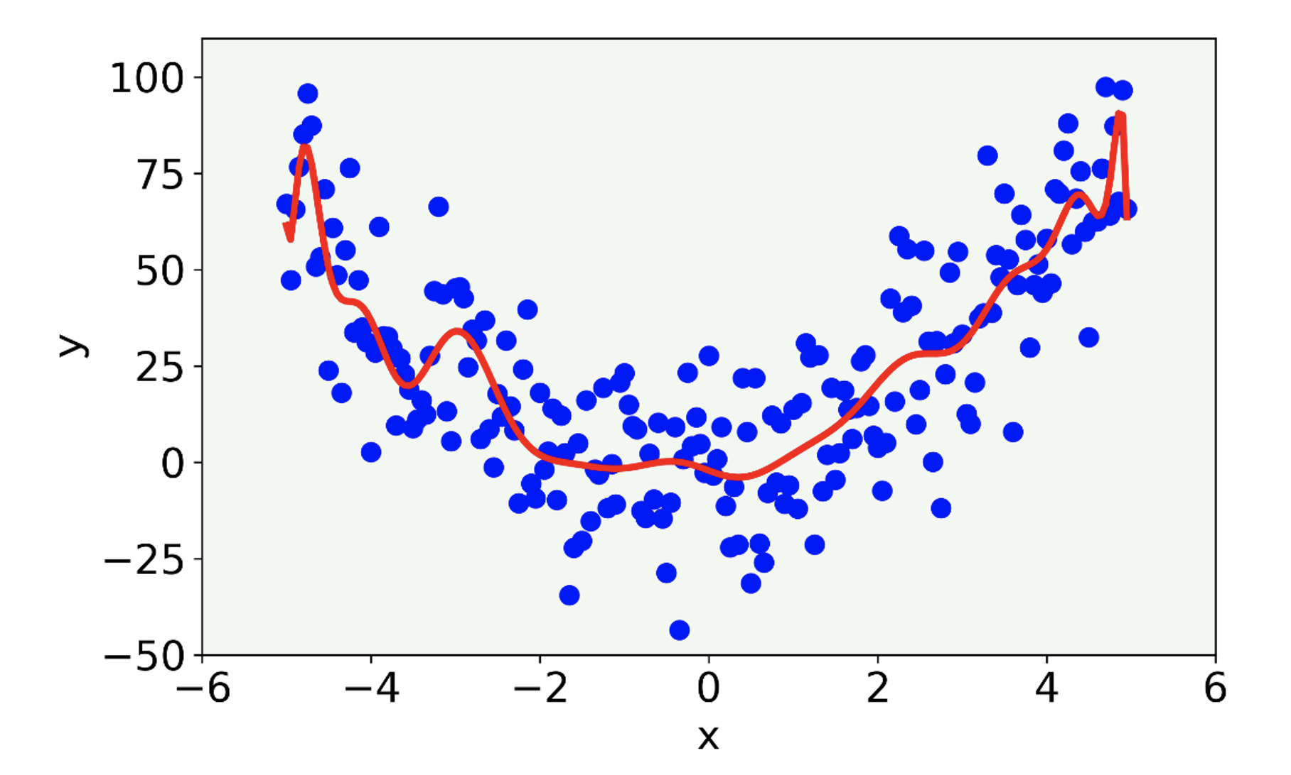
Overfitting IV
The result for a 21-degree polynomial model.
Here we talk about overfitting, since the model capture the noise present in the data.
U. Michelucci, Applied Deep Learning with TensorFlow 2, Springer Nature, 2022

Slide 7
Overfitting V
In most cases a visualisation is not possible, so how can we detect it?
→ To detect it we need to split our dataset in two portion, and use them in a smart way.

Slide 8
Overfitting VI
Process to detect overfitting
Split the dataset in two (Train and Test portions)
Train the model on the "Train" portion
Evaluate the model on the "Test" portion
Compare the metrics on the "Train" and on the "Test" portion of the dataset

Slide 9
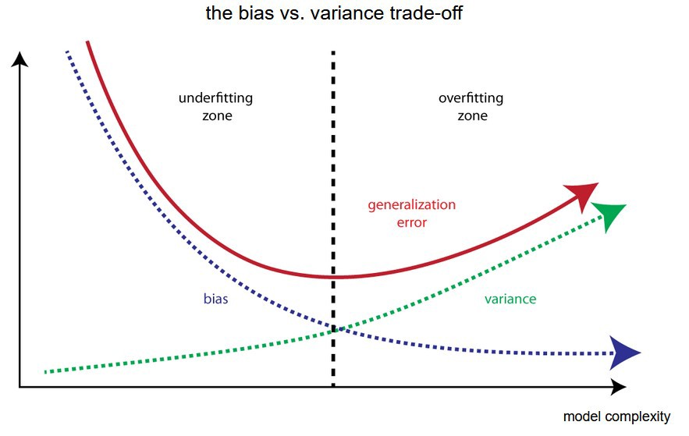
Bias-Variance Trade-off
Metric evaluated on the
“test” dataset
Metric evaluated on the
“train” dataset
Image © Towarddatascience.com

Slide 10
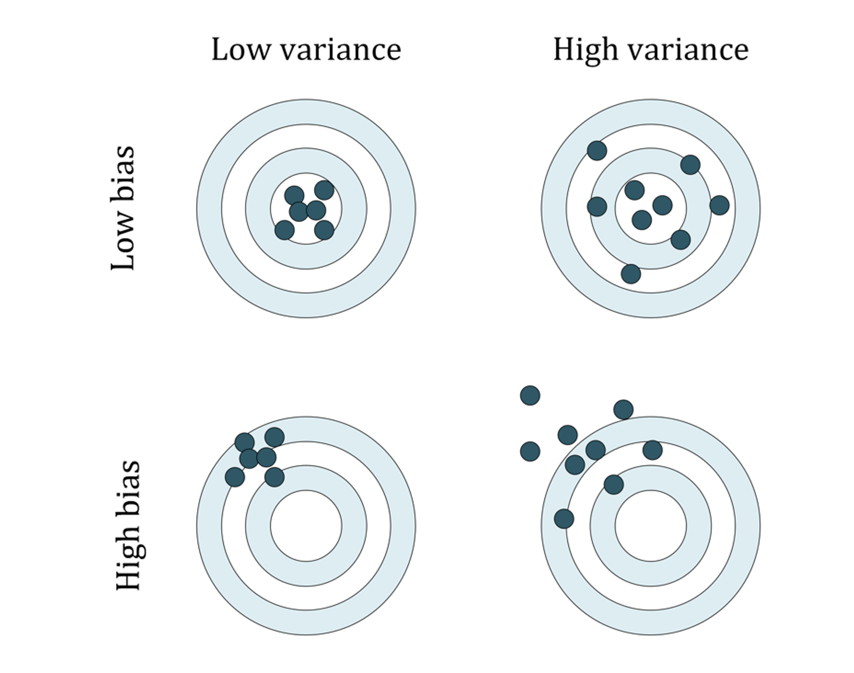
Variance and Bias
U. Michelucci, Applied Deep Learning with TensorFlow 2, Springer Nature, 2022

Slide 11
Essence of overfitting
Note The essence of overfitting is to have unknowingly extracted some of the residual variation (i.e. the noise) as if that variation represented underlying model structure [1]. The opposite is called underfitting when the model cannot capture the structure of the data

Slide 12
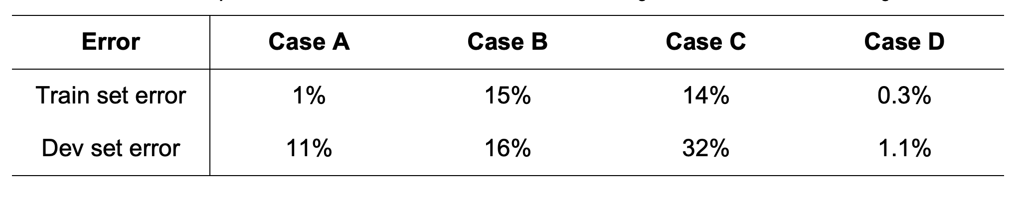
Case A: here we are overfitting (high variance), because we are doing very well on the training set, but our model generalizes very badly to our dev set (check again Figure 15-8).
Case B: here we see a problem with high bias, meaning that our model is not doing very well generally, on both datasets (check again Figure 15-9)
Case C: here we have a high bias (the model cannot predict very well the training set) and high variance (the model does not generalize well on the dev set).
Case D: here everything seems ok. Good error on the train set and good on the dev set. That is a good candidate for our best model.

Slide 13
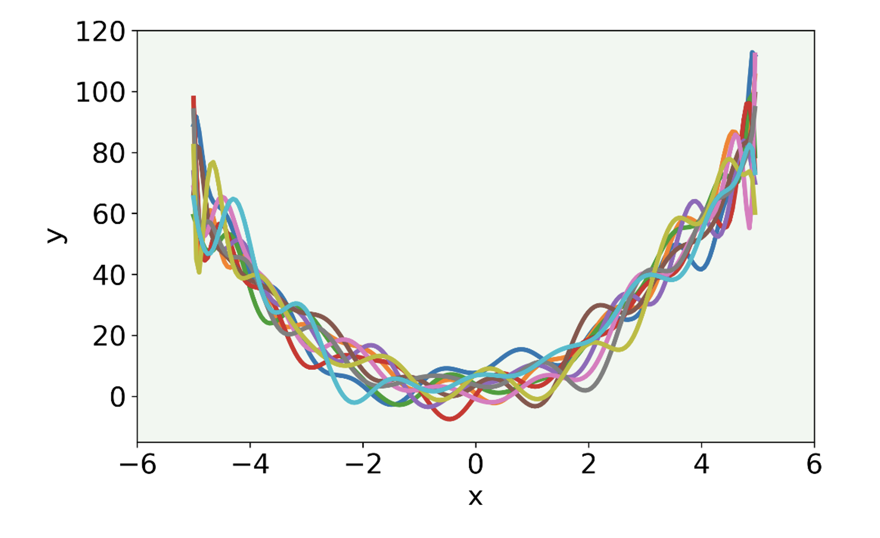
Things are more complicated…
The result of our model with a 21-degree polynomial fitted to 10 different datasets generated with different random noise values added (high variance).
U. Michelucci, Applied Deep Learning with TensorFlow 2, Springer Nature, 2022

Slide 14
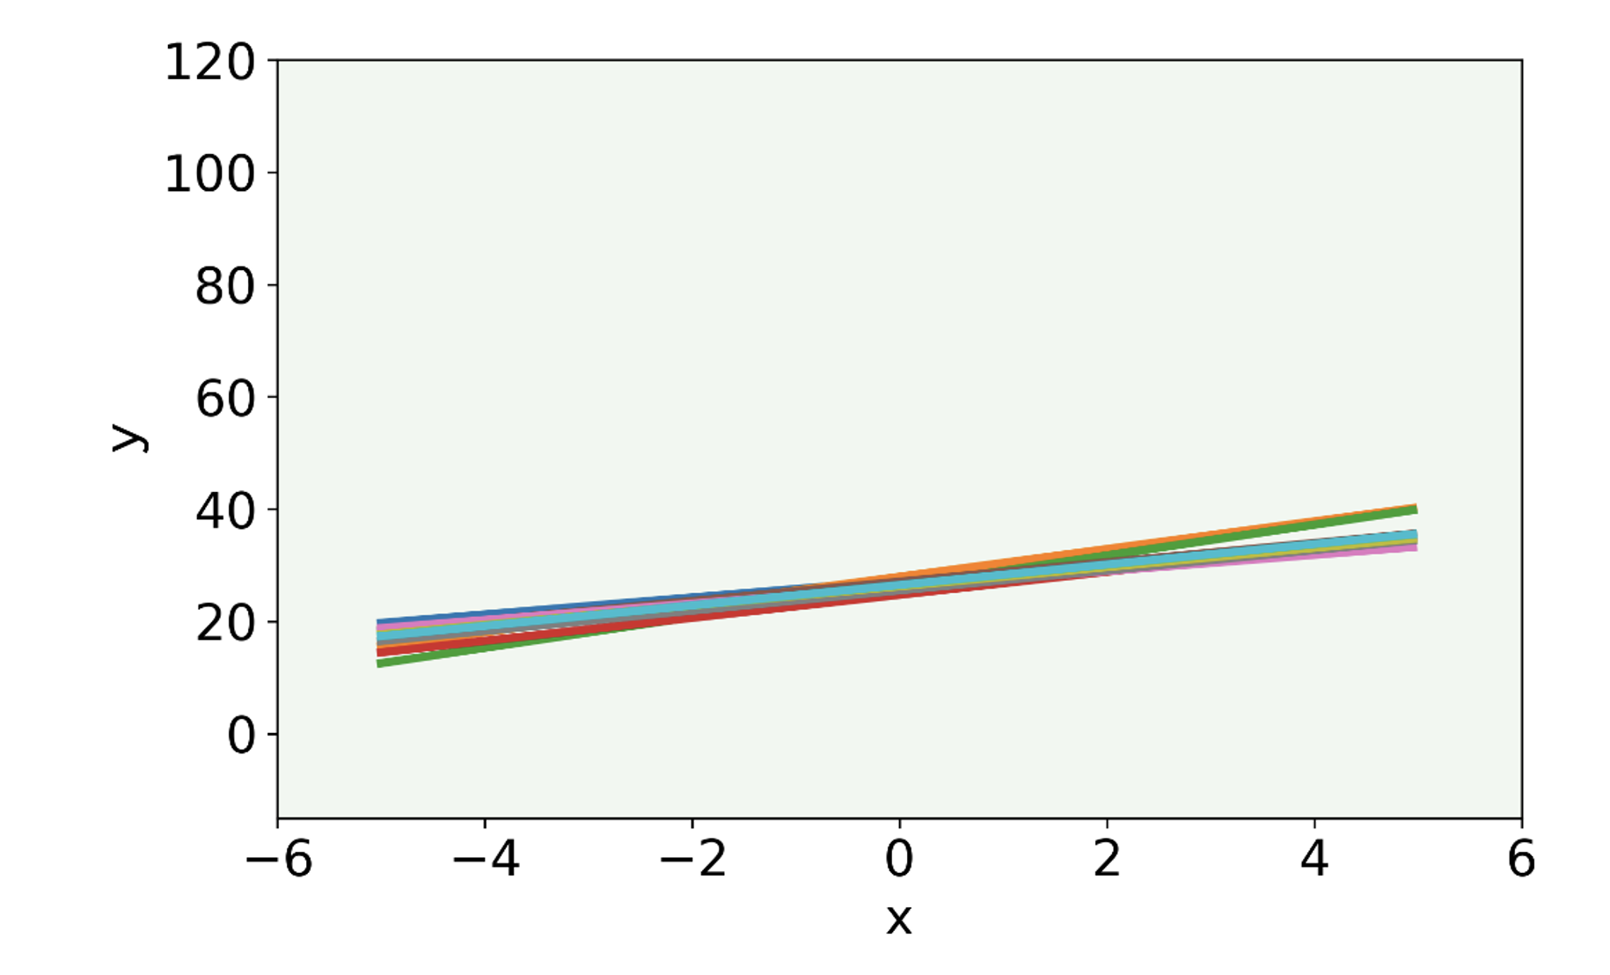
Things are more complicated…
The result of a linear model applied to data where we have randomly changed the random noise.
U. Michelucci, Applied Deep Learning with TensorFlow 2, Springer Nature, 2022

Slide 15
Effect of randomness in the data

